Slide 1


Slide 2

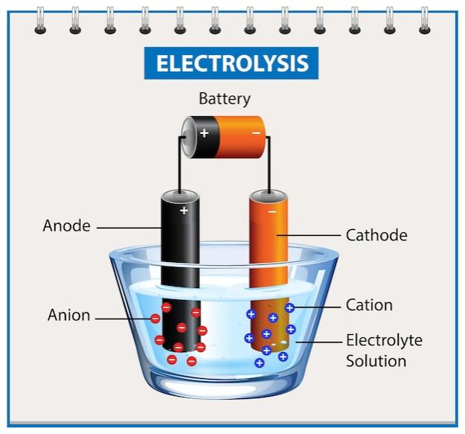
BATTERIES
A Device which contains many electrochemical cells either in series or in parallel which store chemical energy and converts it to Electrical Energy on demand is called as an Electrochemical Battery
Principle Components
● Anode:
● Cathode:
●Electrolyte
●Separator

Slide 3
Types Of Batteries
Primary Battery: A device where electrochemical reactions are irreversible
Ex: Dry cell
2. Secondary Battery: A device where electrochemical reactions are reversible
Ex: Lithium ion Battery
3. Tertiary Battery: A device where electrochemical reactions Continue after adding certain additives.
Ex: UPS

Slide 4

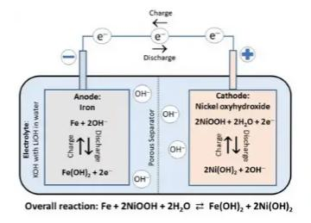
1. Nickel Iron Battery
●Anode: Iron
●Cathode: Nickel(lll) Hydroxide
●Electrolyte: KOH
●Separator: Polypropylene
Working:
Ni(OH)3, during charging, the nickel compound on the positive plates oxidizes to nickel peroxide, while the charging process changes the iron compound on the negative plates to spongy iron.
In the fully charged condition, the active material of the positive plates is nickel hydroxide [Ni(OH)3], while that in pockets of the negative plate is iron, Fe. When the cell delivers current to load, the active material of the positive plate changes from Ni(OH)3 to Ni(OH)2 and that of the negative plate changes from iron to Ferrous hydroxide (Fe(OH)2).

Slide 5
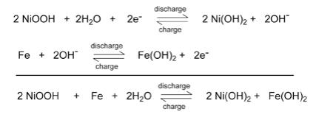
At Cathode:
At anode:
Overall Reaction:
●The weight of this battery is lower because they need less amount of electrolytes and plates are also lighter. ●The service life of the battery is much higher. ●They are not affected by vibrations, jolts or shocks
Advantages
Disadvantages
●Initial cost is high due to need of costly materials
●Low efficiency
Applications
Used in industrial trucks for propulsion purpose and mine locomotives where high mechanical strength is in display

Slide 6


Slide 7
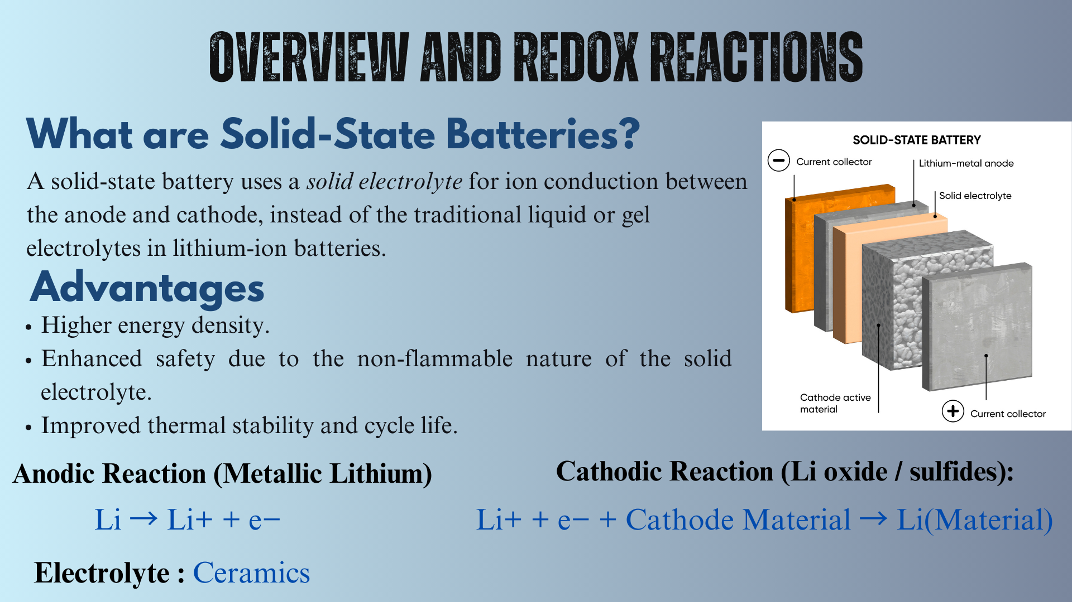

Slide 8
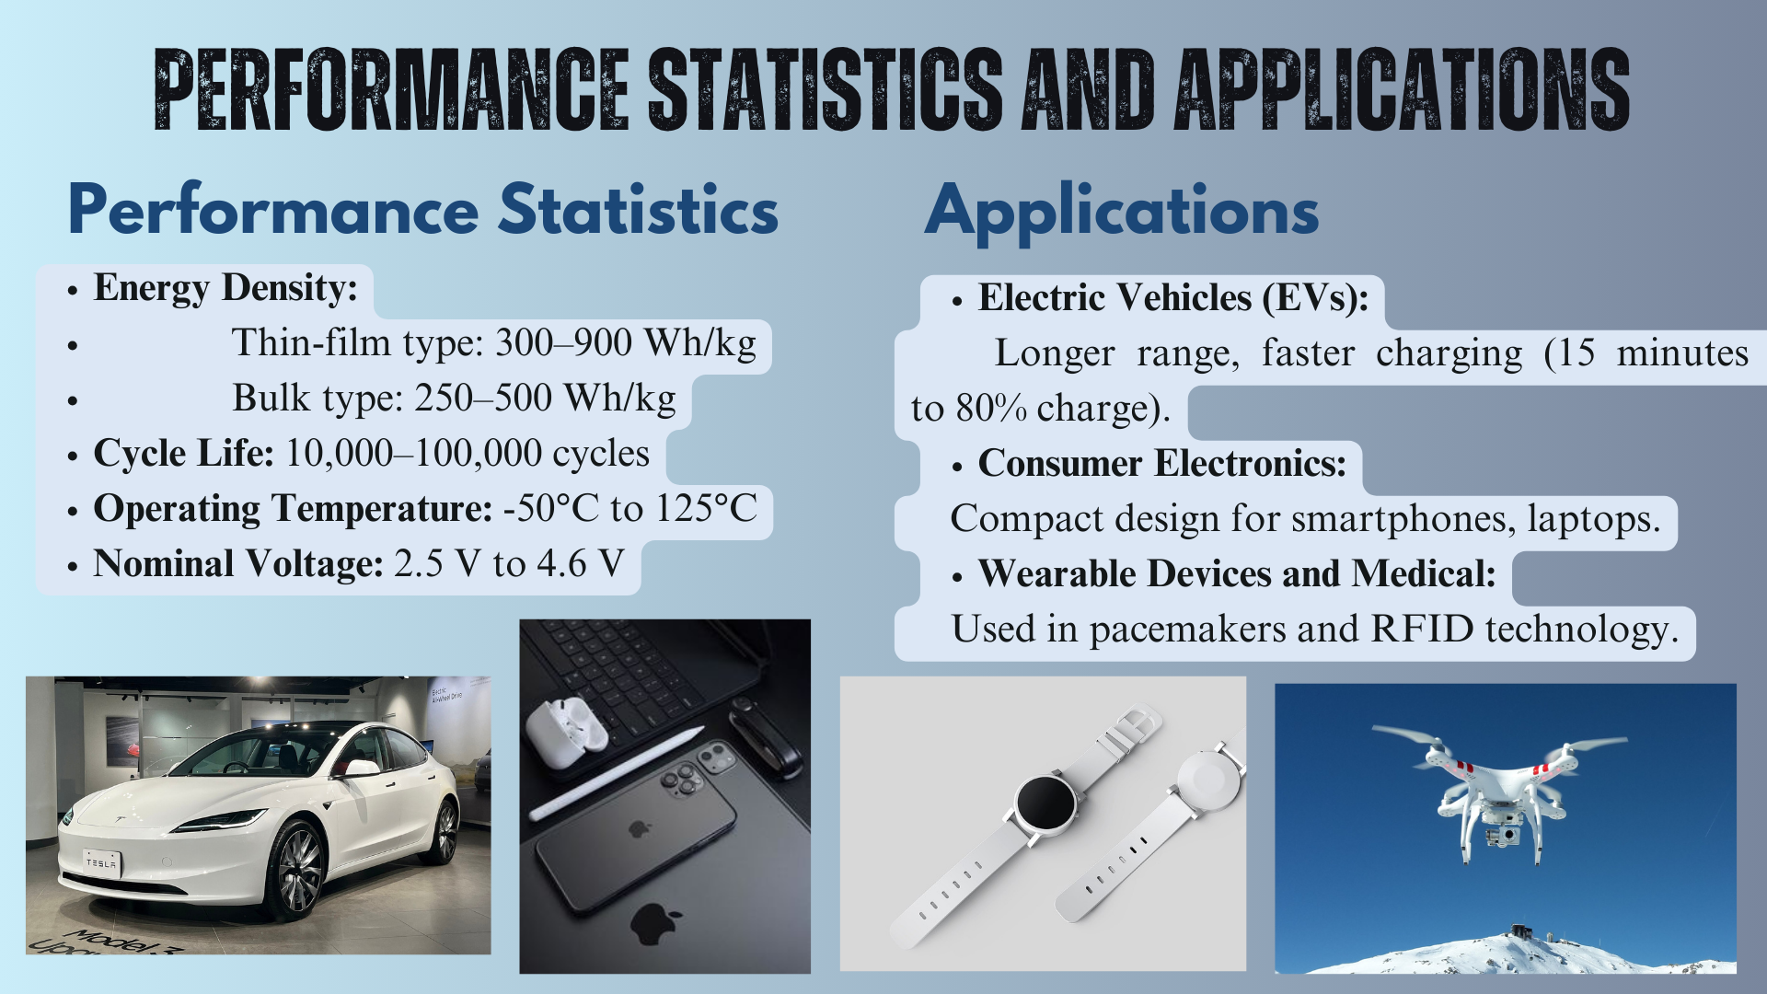

Slide 9
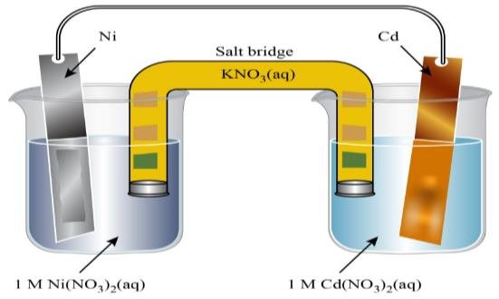
Nickel cadmium battery
Anode: Cadmium (Cd) reacts with hydroxide ions (OH⁻) to form cadmium hydroxide (Cd(OH)₂).
Cathode: Nickel oxyhydroxide (NiOOH) reacts with water to form nickel hydroxide (Ni(OH)₂).
Anode and Cathode Reactions in Ni-Cd Batteries
Anode Reaction (Negative Electrode): Cd+2OH−→Cd(OH)2​+2e−
Cathode Reaction (Positive Electrode):
NiOOH+2H2​O+2e−→Ni(OH)2​+2OH−

Slide 10
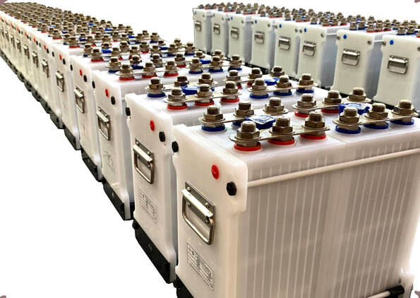


Advantages of Ni-Cd Batteries
High Cycle Life: N-iCd batteries are known for their ability to undergo a high number of charge and discharge cycles (typically 500-1,000 cycles), making them durable and long-lasting for many applications.
Good Performance at Low Temperatures: Ni-Cd batteries can operate in low-temperature environments, which makes them suitable for applications in harsh or cold climates.
Disadvantages of Ni-Cd Batteries
Memory Effect: One of the main disadvantages of Ni-Cd batteries is the "memory effect." If a Ni-Cd battery is repeatedly charged before it is fully discharged, it "remembers" the smaller capacity and loses its ability to hold a full charge. This phenomenon reduces the effective capacity of the battery over time.
Toxicity of Cadmium: Cadmium is a toxic heavy metal, which makes Ni-Cd batteries harmful to the environment if they are not disposed of properly. Improper disposal can lead to soil and water contamination.

Slide 11
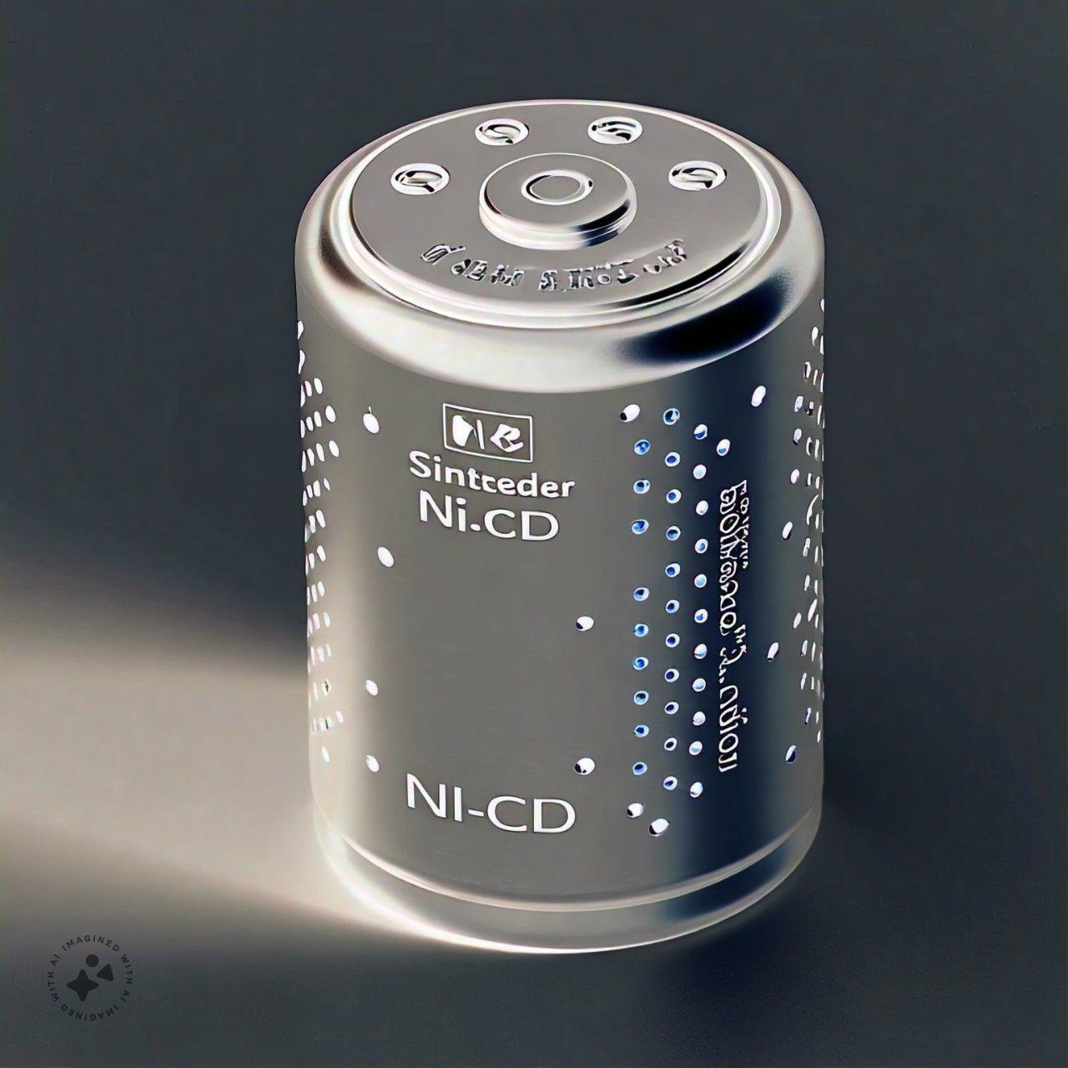
SINTERED NI CD BATTERY

Slide 12
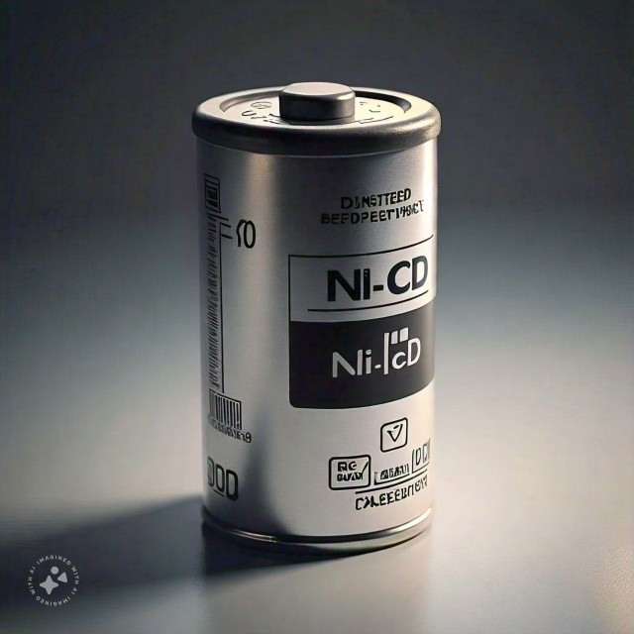
What is sintering ?
Sintering is a process in material science where a solid material is compacted and densified using heat and pressure,
Without melting it . This process involves bonding particles together through atomic diffusion, resulting in a strong
and rigid structure.
Construction
1. Positive Plate(cathode): Nickel oxide hydroxide
(NiOx) is sintered onto a steel grid.
2. Negative plate(anode):Cadmium (Cd) is sintered onto a steel
grid.
3. Separator : A porous material Separate the plates to
prevent short circuits.
Anode reaction
Cd(s)+2OH-(aq) Cd(OH)2(s)+2e-
Cathode reaction:
2NiOx(s)+2H2O(I)+2e-
2Ni(oH)2(s)+2OH-(aq)

Slide 13
SINTERED NI CD BATTERY

Slide 14
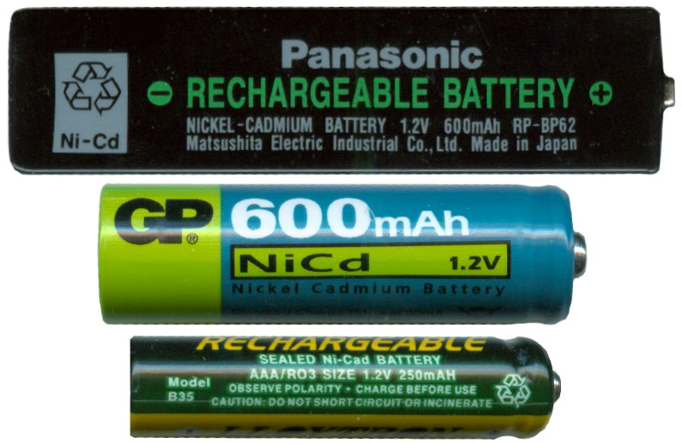
Working principle
Chemical reaction : Nickel oxide
hydroxide(NiOx) reacts with cadmium
(Cd) to produce electricity.
2. Electrolyte: Potassium hydroxide
(KOH) facilitates ionic conduction.
Applications : Aviation systems, industrial tools, emergency
lighting, and backup power.
Advantages
Higher energy density compared to pocket NiCd batteries.
Can handle overcharging and fast charging.
Durable with a long operational life.
Disadvantages
Contains cadmium, which is environmentally hazardous.
More expensive then other operational life.

Slide 15
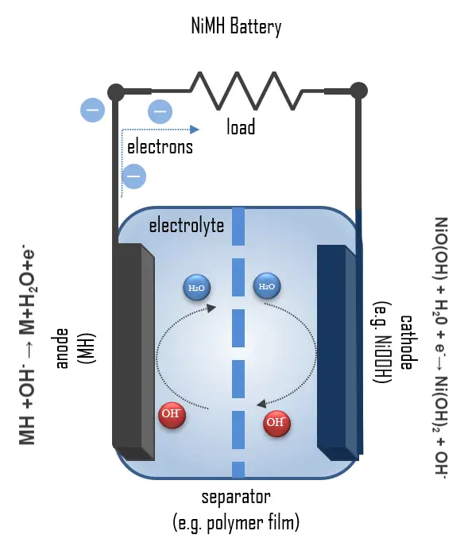

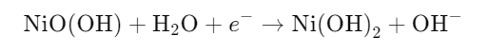
Introduction to NiMH Batteries
What is a NiMH Battery?
A Nickel-Metal Hydride (NiMH) Battery is a rechargeable battery where the anode uses a hydrogen-absorbing alloy, and the cathode uses nickel oxyhydroxide (NiOOH).
Evolved from Ni-Cd batteries, offering higher capacity and reduced toxicity.
Anodic Reaction (Oxidation)
Cathodic Reaction (Reduction)
Nominal Voltage: ~1.2 V per cell.

Slide 16
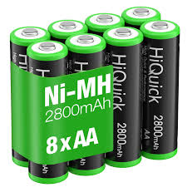

Applications and Advantages
Applications :
Consumer Electronics: Digital cameras, remote controls, and toys.
Automotive: Widely used in hybrid vehicles like the Toyota Prius.
Industrial: Backup power systems and medical devices.
Advantages :
Higher energy density than Ni-Cd batteries.
Safer and more environmentally friendly (no cadmium).
Robust performance across various temperatures.

Slide 17

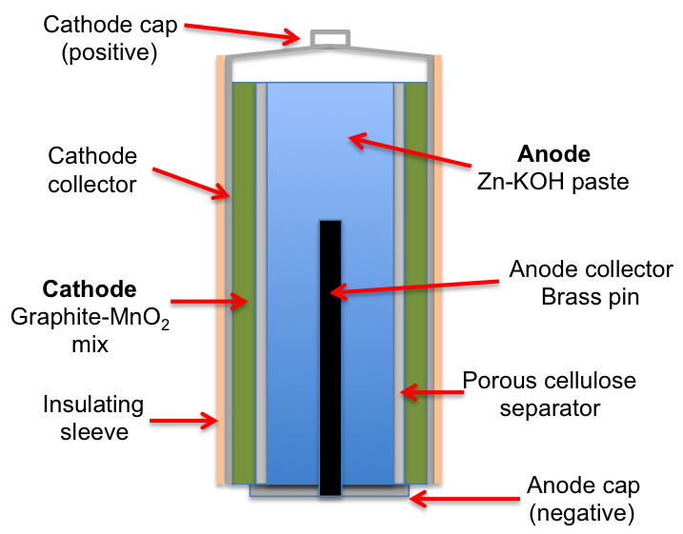
Alkaline Battery
An alkaline battery is a type of primary battery where the electrolyte has a pH value above 7. Typically these batteries derive energy from the reaction between zinc metal and manganese dioxide.
Construction:-
Anode:-Zinc
Cathode:-Manganese dioxide
Separator:-Polypropylene
Electrolyte:-KOH

Slide 18
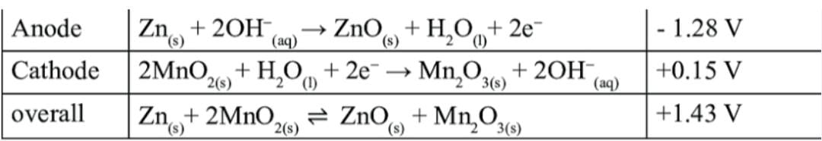
Working:-
Zinc Oxidation:- Zinc reacts with hydroxide ions to form zinc oxide and release electrons.
Manganese Dioxide Reduction:-Manganese dioxide reacts with water and electron to form manganese oxide hydroxide and release hydroxide ions.
Zinc and Manganese Dioxide:-The overall reaction involves the oxidation of zinc the reduction of manganese dioxide resulting in the generation of electricity.
Common Uses:-
Flashlights, Toys, Remote Controls , Radios, Other Portable devices

Slide 19
Advantageous:-
Alkaline Batteries are reliable and consistent in their performance.
They are widely available in various sizes and formats.
They are cost effective compared to rechargeable batteries.
Disadvantageous:-
Alkaline Batteries are disposable and cannot be reused.
They contain toxic materials like mercury and lead, which can harm the environment if not disposed of property.
They have limited energy storage capacity compared to rechargeable batteries.
Safety Precautions:-
Handle alkaline batteries with care to avoid damage or leakage.
Dispose of alkaline batteries property to avoid environmental harm.
Avoid mixing alkaline batteries with other type of batteries.
Keep alkaline batteries out of reach of children and pets.

Slide 20


